Slide 1
Karting Sponsorship Opportunities
Fuel a Dream

Slide 2
Introduction
This exciting sponsorship opportunity offers:
Brand Exposure
Customer Engagement
Brand Association
Product Showcase
Offering a tiered sponsorship package allowing sponsors to choose a level that best fits their budget and goals.
Karting has a massive motorsport following, its audience is vast as there are male and female drivers of all ages and young Karters’ are accompanied by their parents who work in all different industries. For some it is not possible to progress without funding.

Slide 3
About me.
From a baby I was fascinated with cars, and apparently ‘car’ was my first word. When I was 2 my parents bought me an electric mini cooper for Christmas which was my first car, and from that point I just loved driving. My driving skills at 2 years old even impressed our neighbour, a professional driving instructor. From the time I could speak my parents and relatives often talk about my remarkable ability to identify the make and model of vehicles at such a young age.
When I watched Formula 1 with my dad I was so fascinated with the speed and sounds of the cars I dreamed of becoming an F1 driver. By the time I was 4 years old my dad was looking into signing me up for karting but was told we had to wait until I was 6. At age 6 my dad signed me up for karting and my heart has been set on becoming a successful racing driver ever since. I have been racing corporate karts competing in club championships at Buckmore Park, Rye House (both places were stomping grounds of Lewis Hamilton) and Club 100 who run national championships across the UK.
In 2022 I was invited by Lewis Hamilton to attend the British Grand Prix as part of his pursuit to promote diversity in racing. Aas evidenced in the next 2 slides, we were given VIP access to The Hamilton Suite on practice day and met his Dad and the Mercedes team as well as a tour of the paddock.
My dad has dedicated himself to providing me with as much track time as possible, allowing me to hone my skills and compete in local and regional races. My commitment and sportsmanship have earned me recognition and respect among fellow racers and coaches. In motorsport, track time is important however, my track time is limited due to lack of funds
This year I have entered the world of Owner Driver racing as part of the Project One driving team in an owner driver championship and in my first race came 3rd against competitors who have been at this level for over a year. We are hiring the kart on a race-by-race basis. I am only able to attend one practice session per month on the day before the race and would love to have more track time as I know I have the speed and the ability to enhance my racing craft. I’m often only 0.10 seconds off pole’s time who has several years experience as owner driver over me.
I’m hoping with funding I can enter the British Championships next year where there is more exposure and competition opportunities

Slide 4
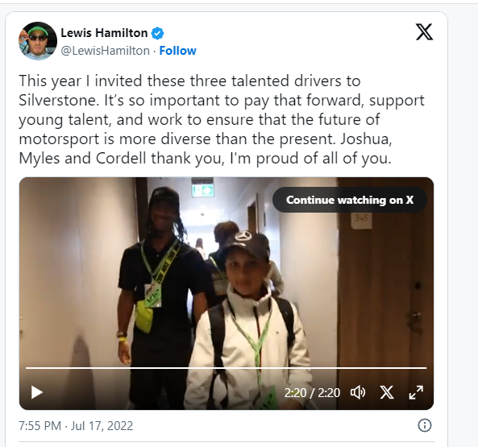
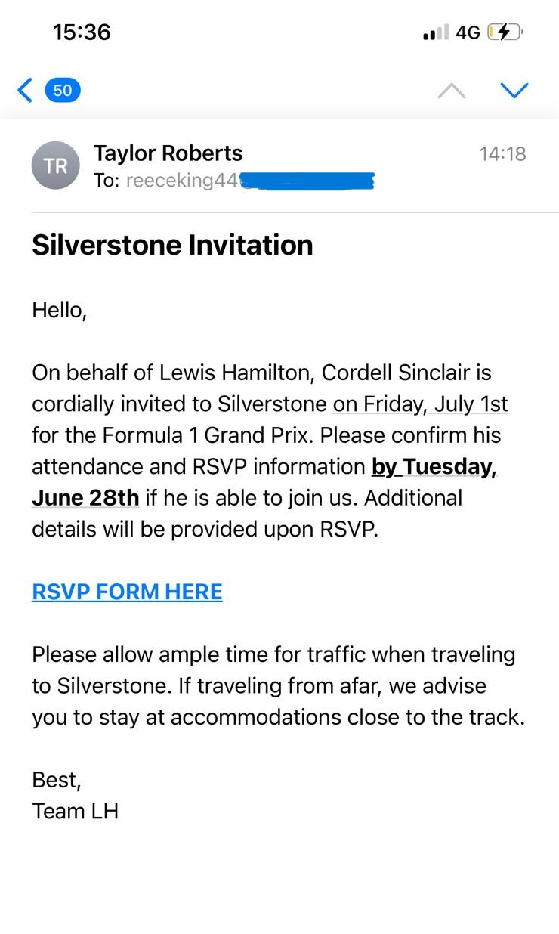
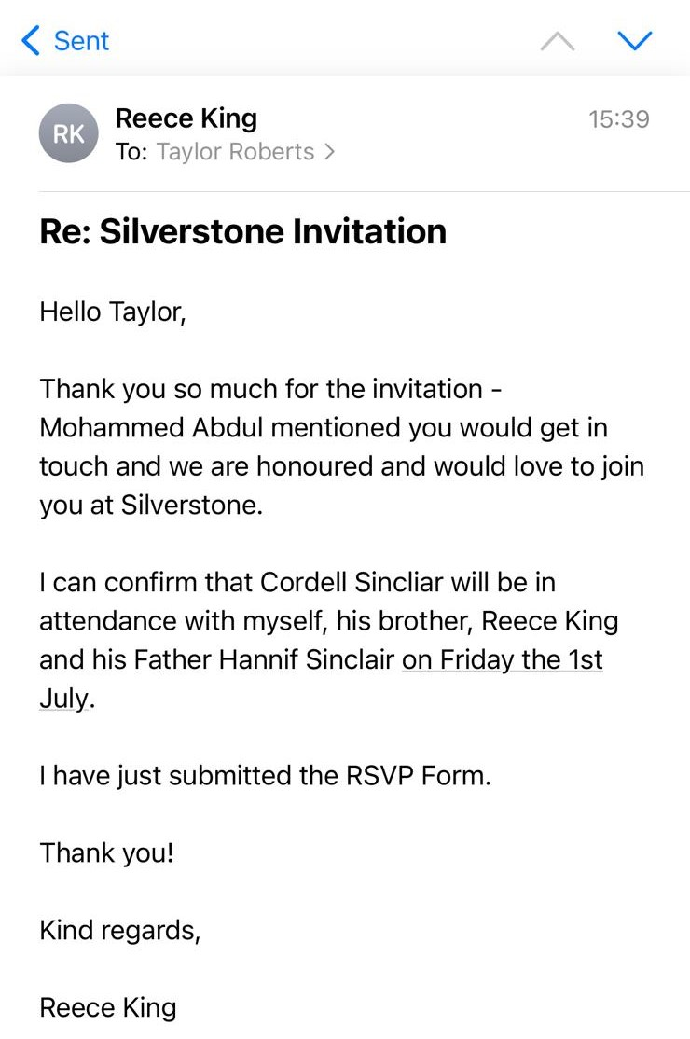
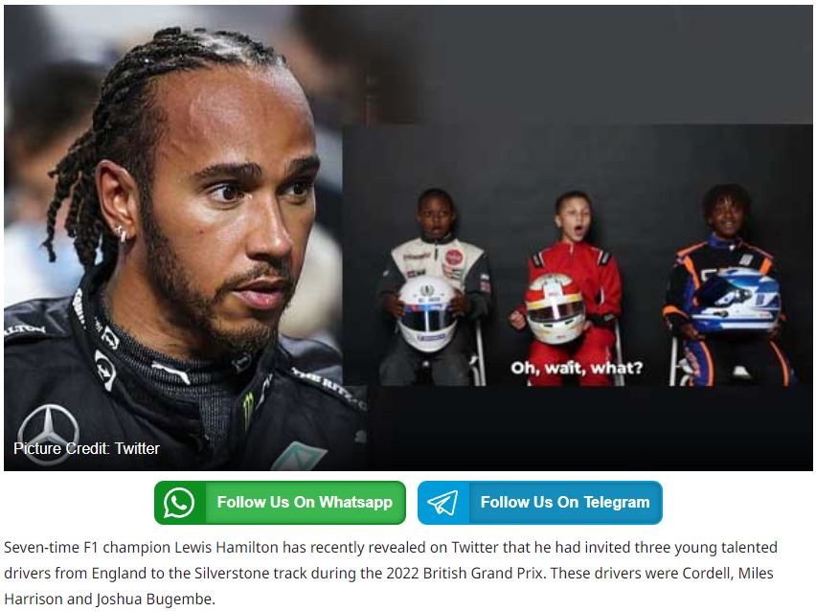

Slide 5
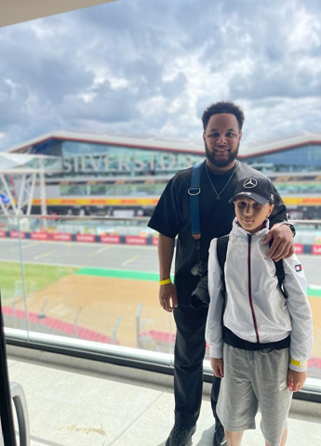
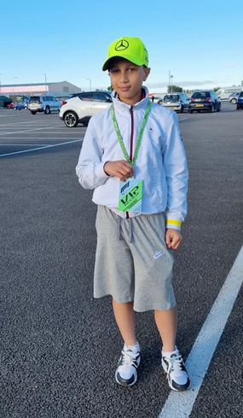
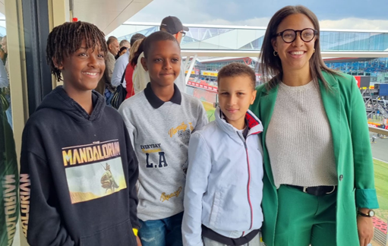
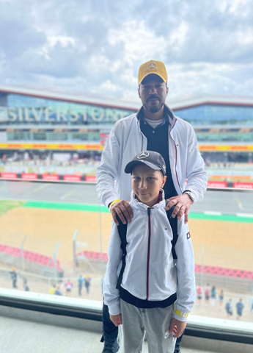
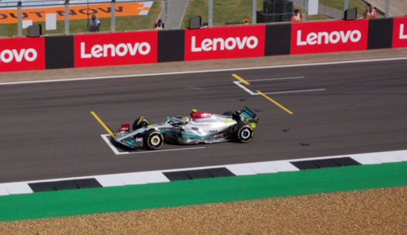

Slide 6
We are seeking your support to help fund Cordell's burgeoning karting career. Cordell has reached a pivotal point in his journey, where becoming an Owner Driver and joining a competitive team is crucial for advancing his talent and gaining recognition in the racing community.
Your generous contributions will directly assist with:
Kart and Equipment: Ensuring Cordell's safety and performance by investing in a reliable kart, tyres, fuel and essential safety gear.
Race Fees and Travel Expenses: Supporting Cordell's participation in regional and national competitions, providing valuable experience and exposure.
Training and Coaching: Enabling Cordell to receive professional coaching to enhance his skills and knowledge of the sport.
Media Exposure: Getting a website up and running providing more exposure for our sponsors alongside social media.
Your sponsorship can provide Cordell with the equipment and opportunities he needs to chase his dreams and represent our community on the national and international karting stage. Every contribution, no matter how small, brings Cordell one step closer to achieving his goal of becoming a Formula 1 driver.
Join us in supporting our budding young racer, Cordell, as he embarks on this thrilling journey. Your generosity will not only make a difference in Cordell's life but also inspire him to continue pursuing his passion for karting and to inspire ethnic minorities to embrace the sport, fostering inclusivity in a field where representation is vital. Your sponsorship will not only support his racing journey but also contribute to encouraging a more diverse generation of drivers.
Thank you for considering this sponsorship opportunity. I am confident that your support will have a meaningful impact on Cordell's journey and reflect positively on your company's commitment to fostering talent and community development.

Slide 7
Available Tiers
Bronze Sponsor
Cost: £500 - £1,500
Benefits:
Logo Placement: Small logo on kart and driver's suit
Social Media Mentions: Monthly mentions on social media
Thank You Note: Mention in race reports or newsletters
Silver Sponsor
Cost: £1,500 - £3,000
Benefits:
Logo Placement: Medium logo on kart, driver's suit, and helmet
Social Media: Bi-weekly mentions with tagged posts
Merchandise: Branded merchandise (e.g., hats, T-shirts)
Gold Sponsor
Cost: £3,000 - £5,000
Benefits:
Logo Placement: Prominent logo on kart, suit, and helmet
Social Media: Weekly posts and story mentions
Merchandise: Branded merchandise (e.g., hats, T-shirts)
Exclusive Content: Behind-the-scenes content featuring the sponsor

Slide 8
Future Available Tiers
Platinum Sponsor
Cost: £5,000 - £10,000
Benefits:
Logo Placement: Exclusive branding on kart, suit, helmet, and team gear
Social Media: Daily mentions and exclusive posts
[Website and Newsletter: Prominent feature on the website homepage and newsletters
Events: Full display rights at events
Hospitality: Full VIP race day package including accommodation
Exclusive Access: Behind-the-scenes access, strategy meetings
Content Creation: Custom content tailored to sponsor’s needs]
4
Title Sponsor
Cost: £10,000+
Benefits:
Title Branding: Team named after the sponsor (e.g., “Sponsor Name Racing Team”)
Logo Placement: Dominant branding on all team materials
Social Media: Custom campaigns including frequent posts
Website and Newsletter: Exclusive sections dedicated to the sponsor
Events: Full rights to display products and host activities
Hospitality: Ultimate VIP package, private hospitality suite
Engagement: Personalized content, video interviews
Annual Review: Comprehensive sponsorship report, strategic review meeting
5
3
Additional Customisable Options
Driver Appearances: Personal appearances by the driver
Product Endorsements: Driver endorsements of sponsor’s products
Workshops/Training: Driving workshops or training sessions
Custom Branding: Specific customization to match sponsor’s branding

Slide 9
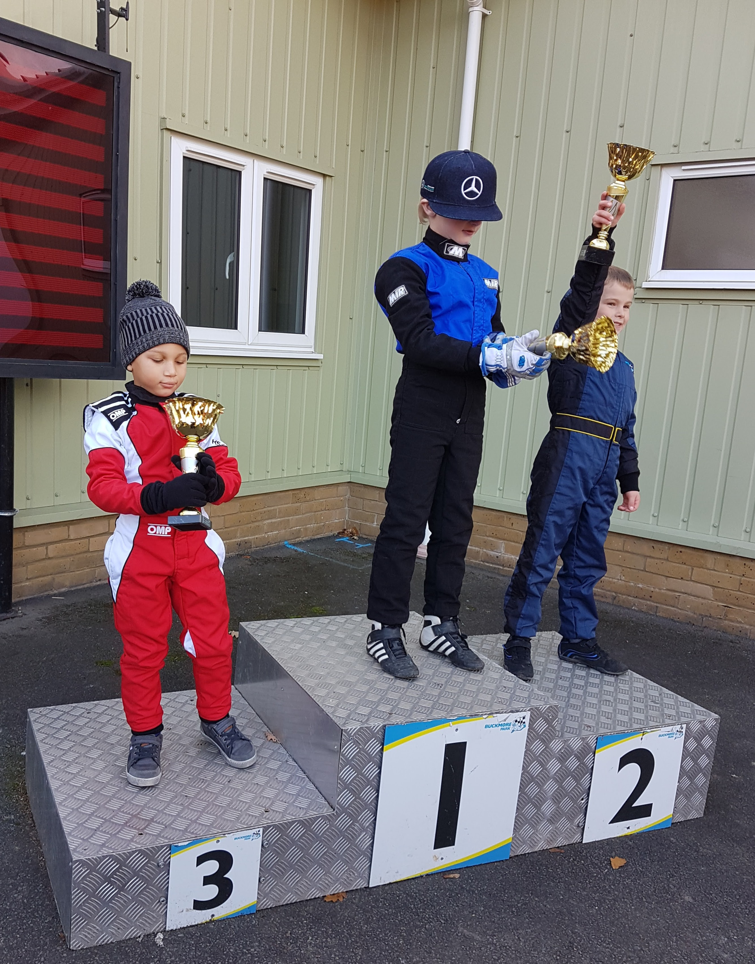
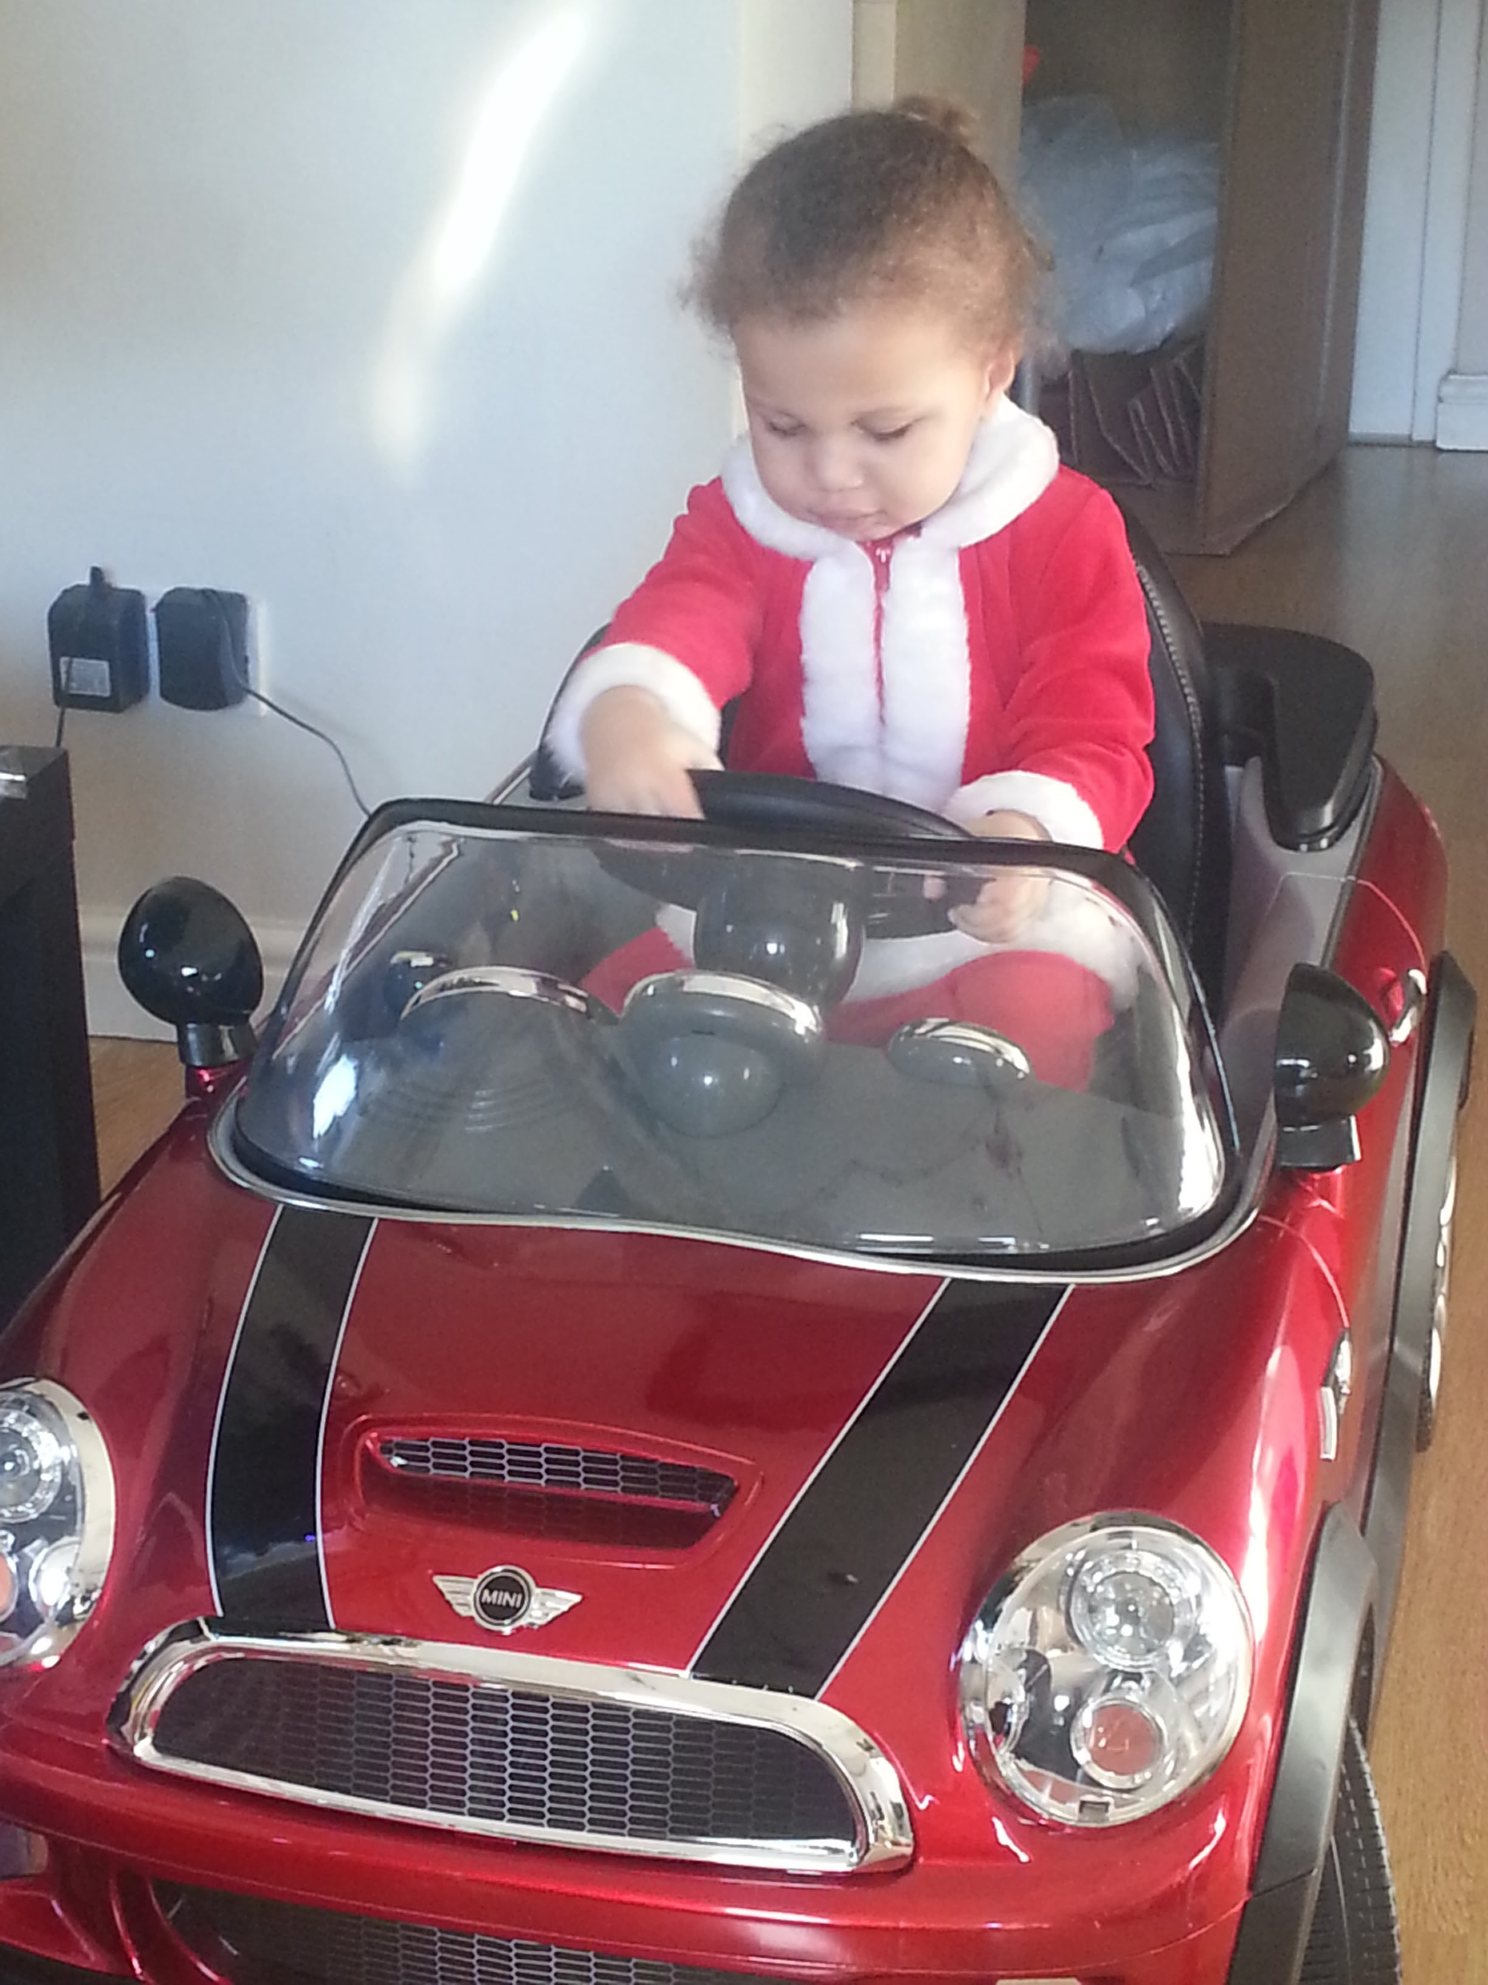
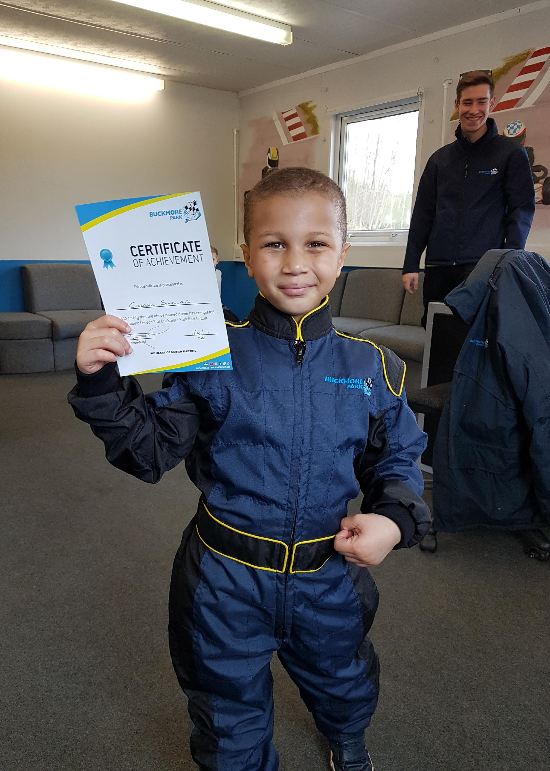
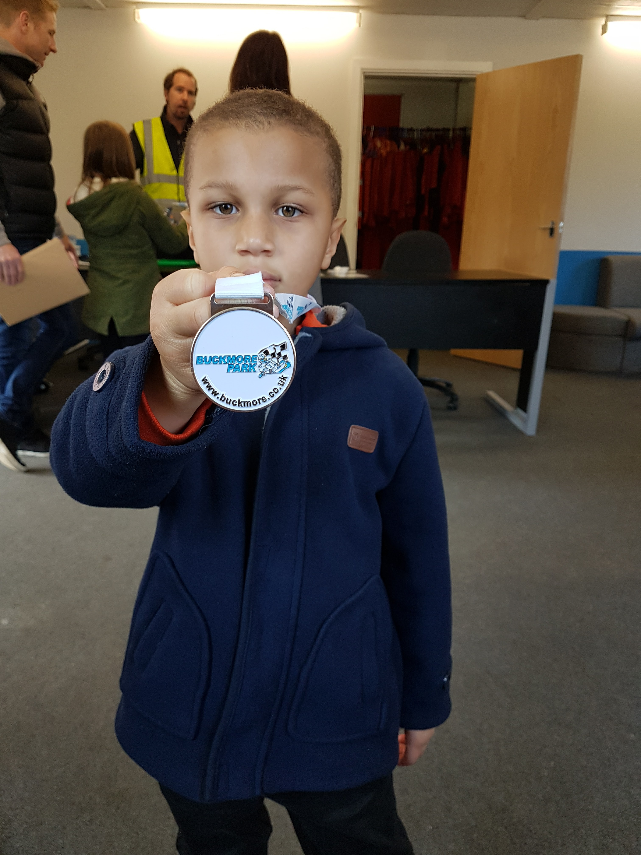
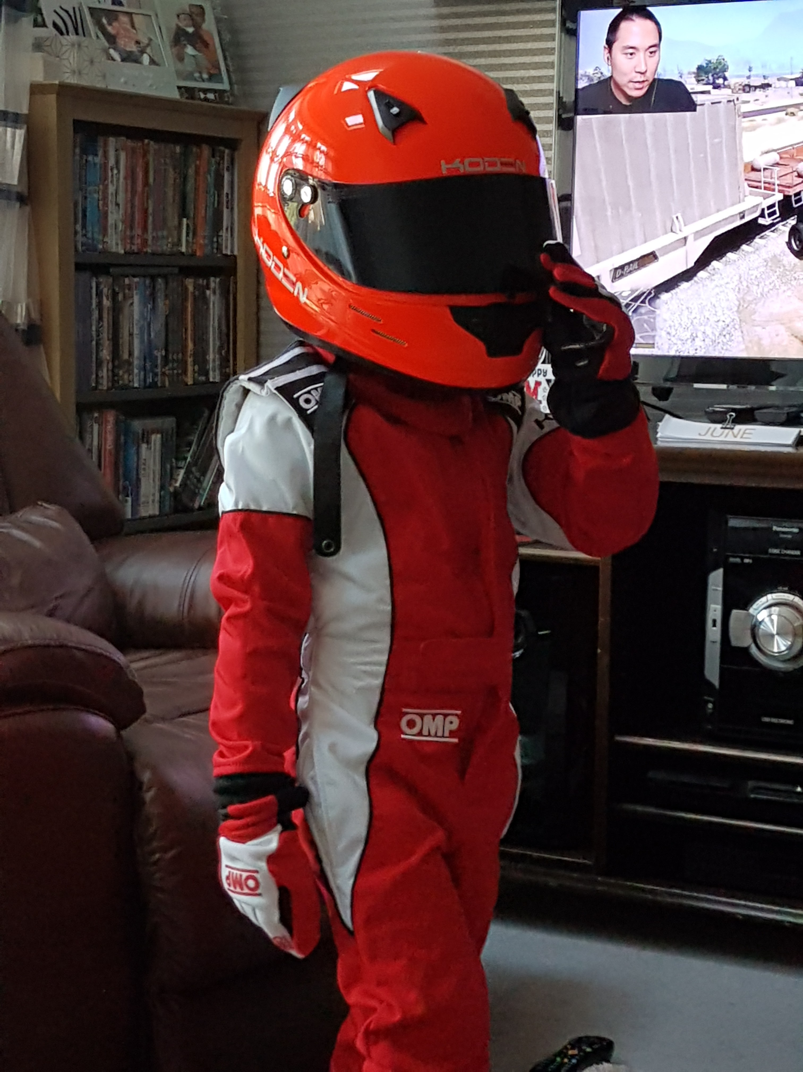
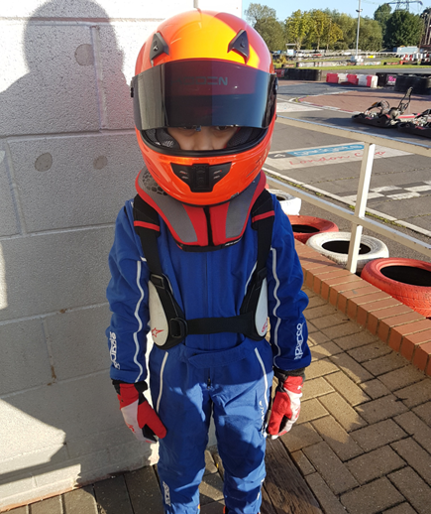
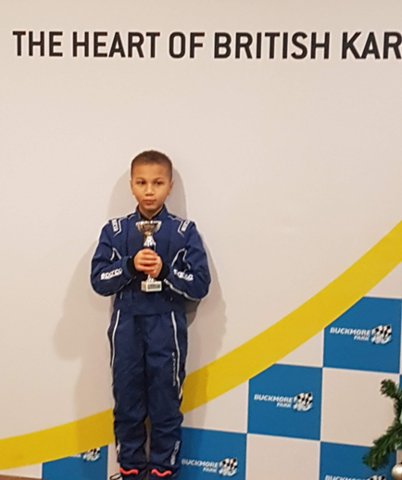
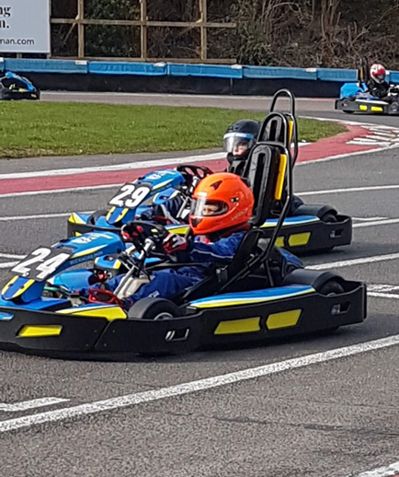
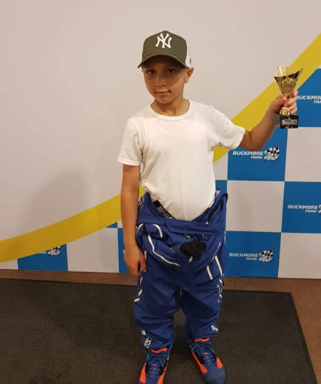
Gallery 2017 - 2019
…And so it begins

Slide 10
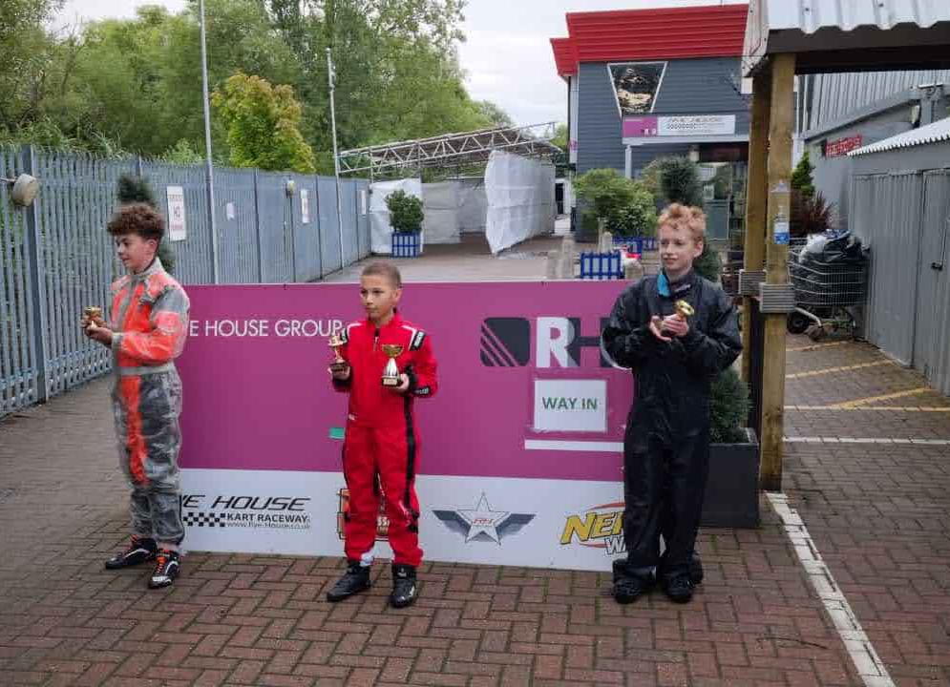
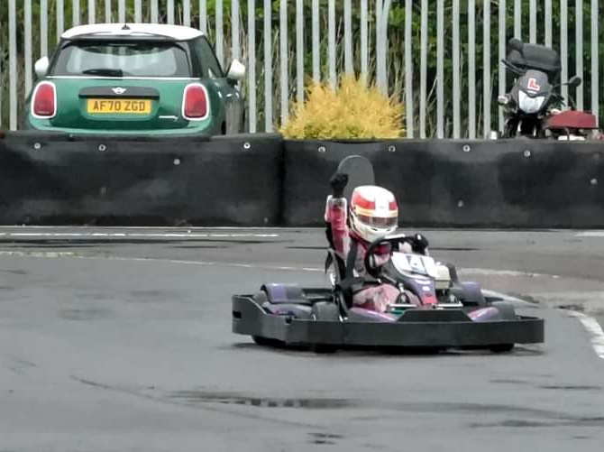
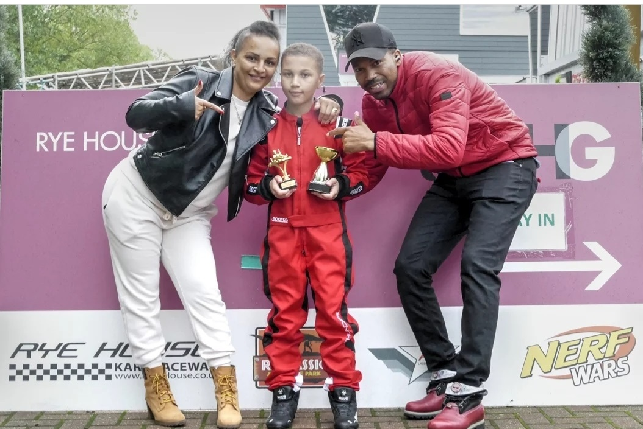
Gallery
2021
Worked hard for this Win!

Slide 11
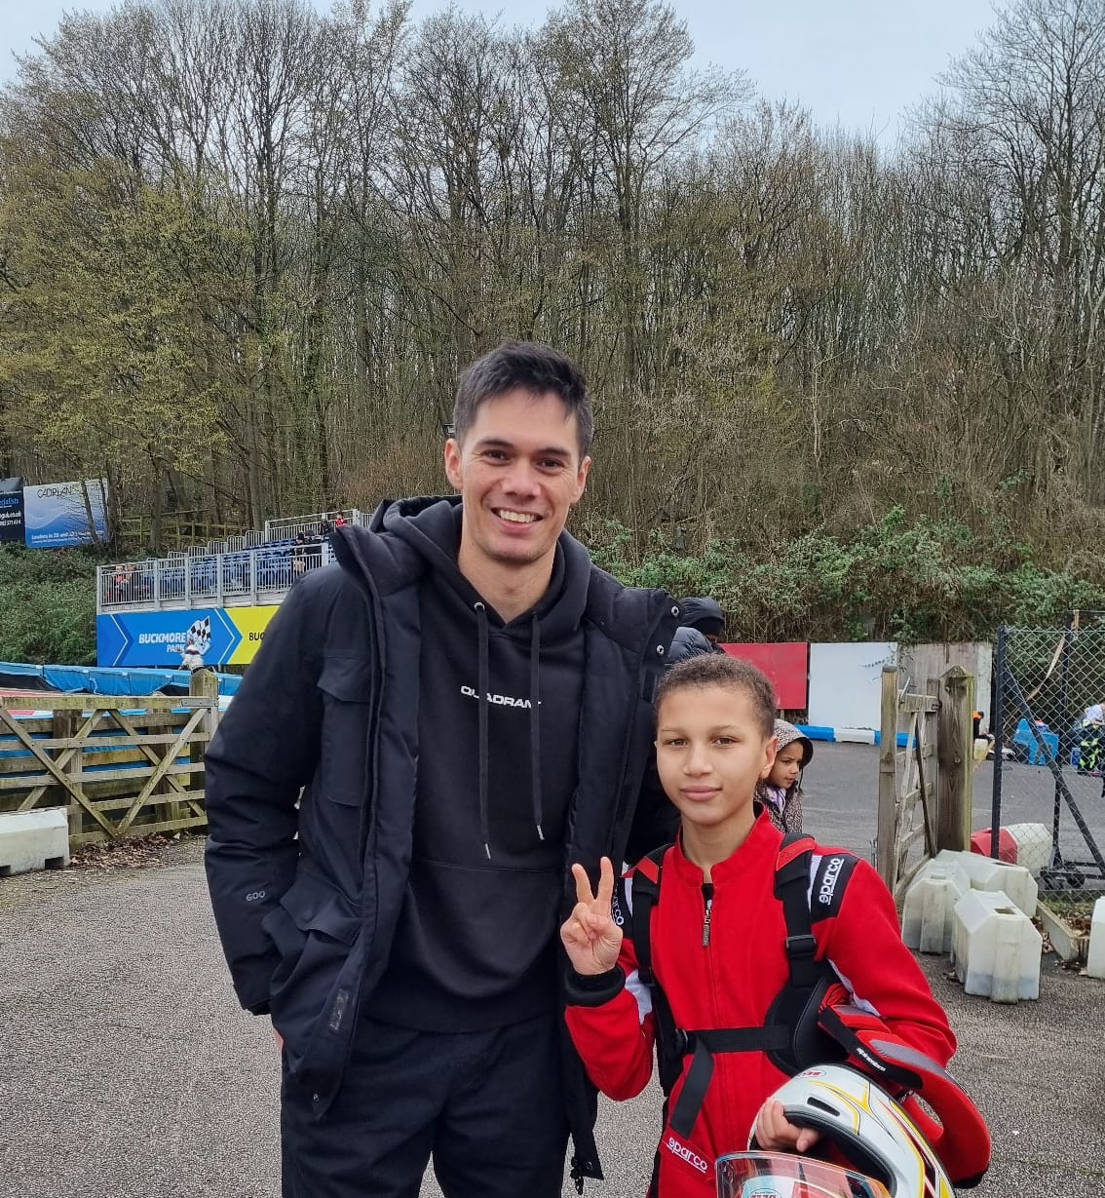
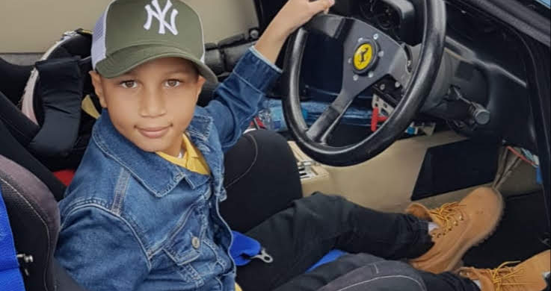
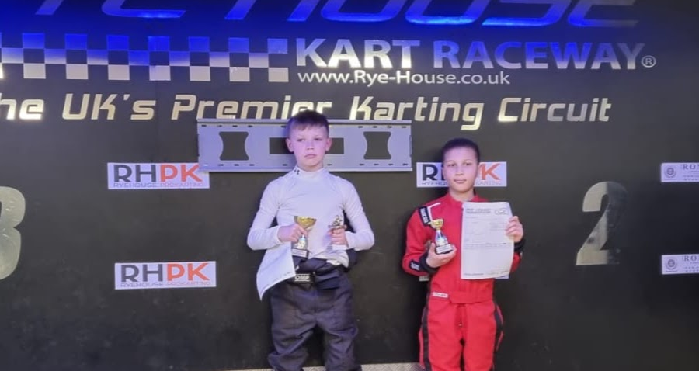
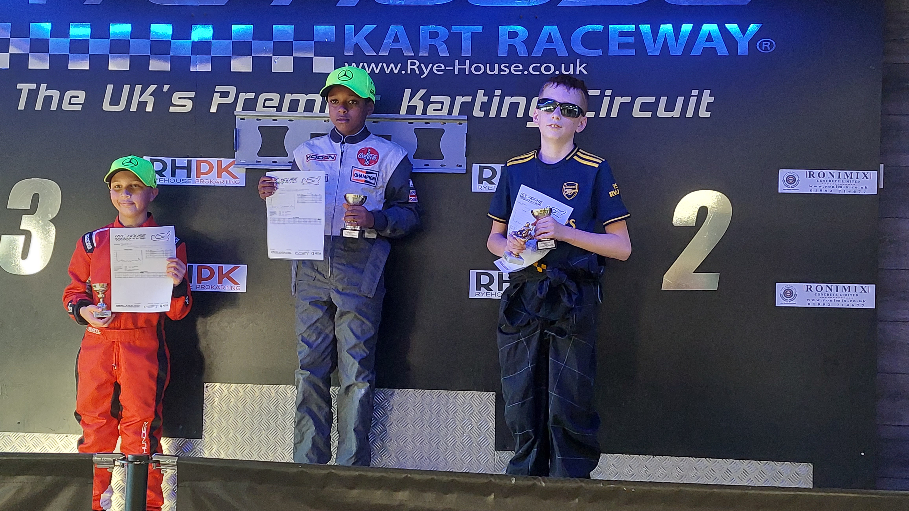
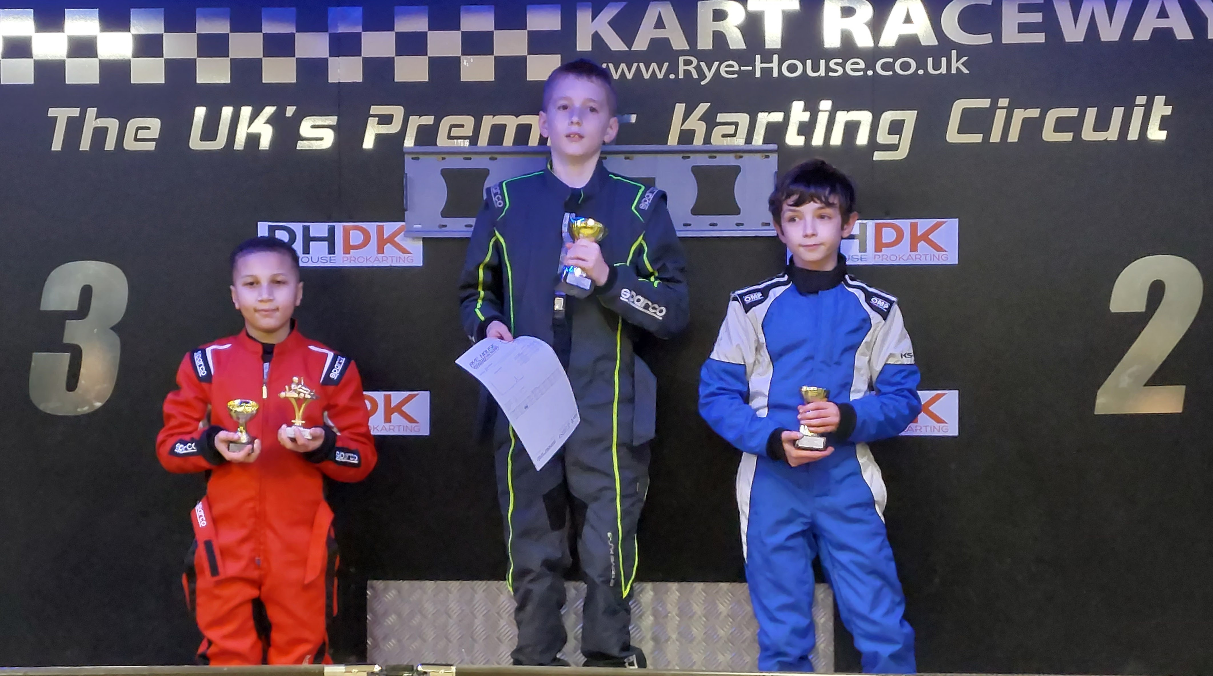
Gallery
2021/22

Slide 12
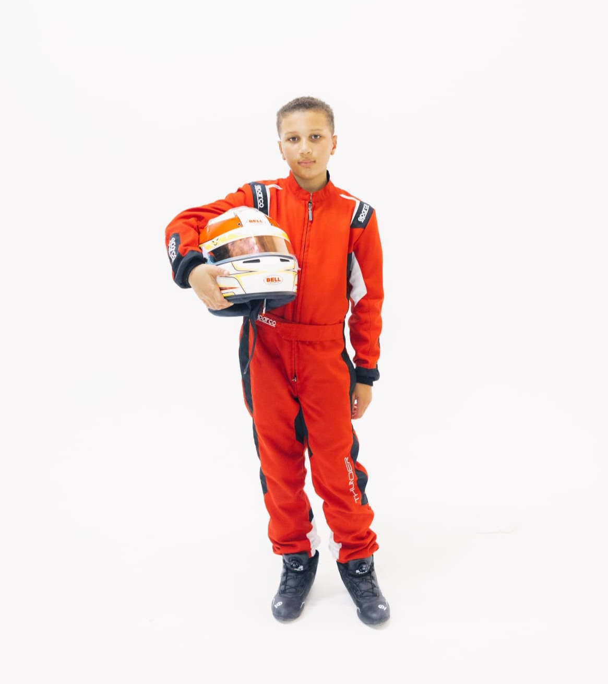
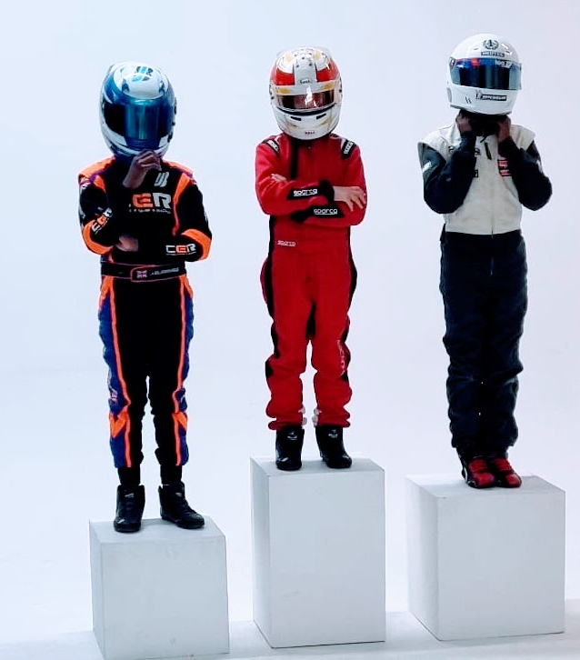
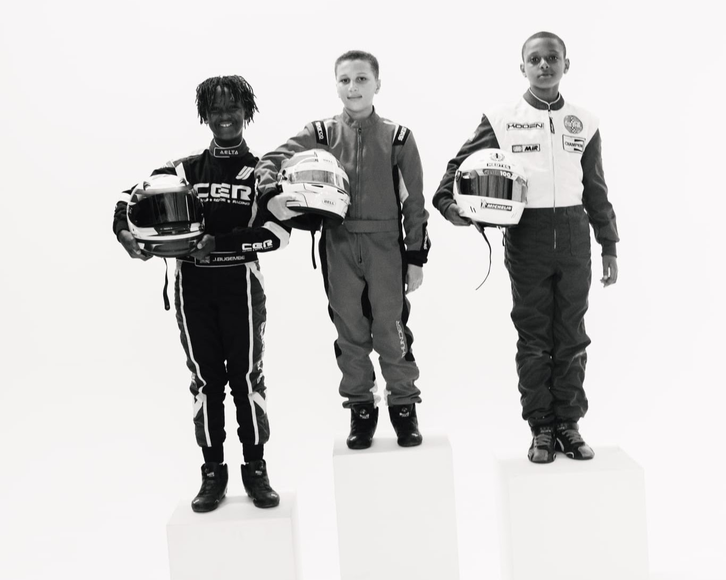
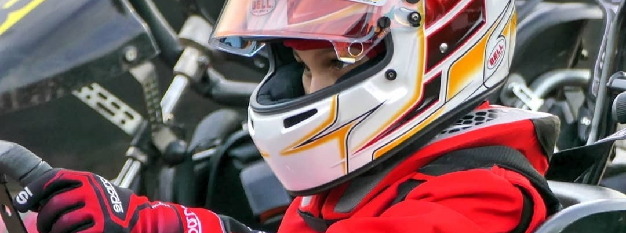
Gallery
Photo Shoot 2022
Invited by Lewis Hamilton to attend British Grand Prix Practice

Slide 13
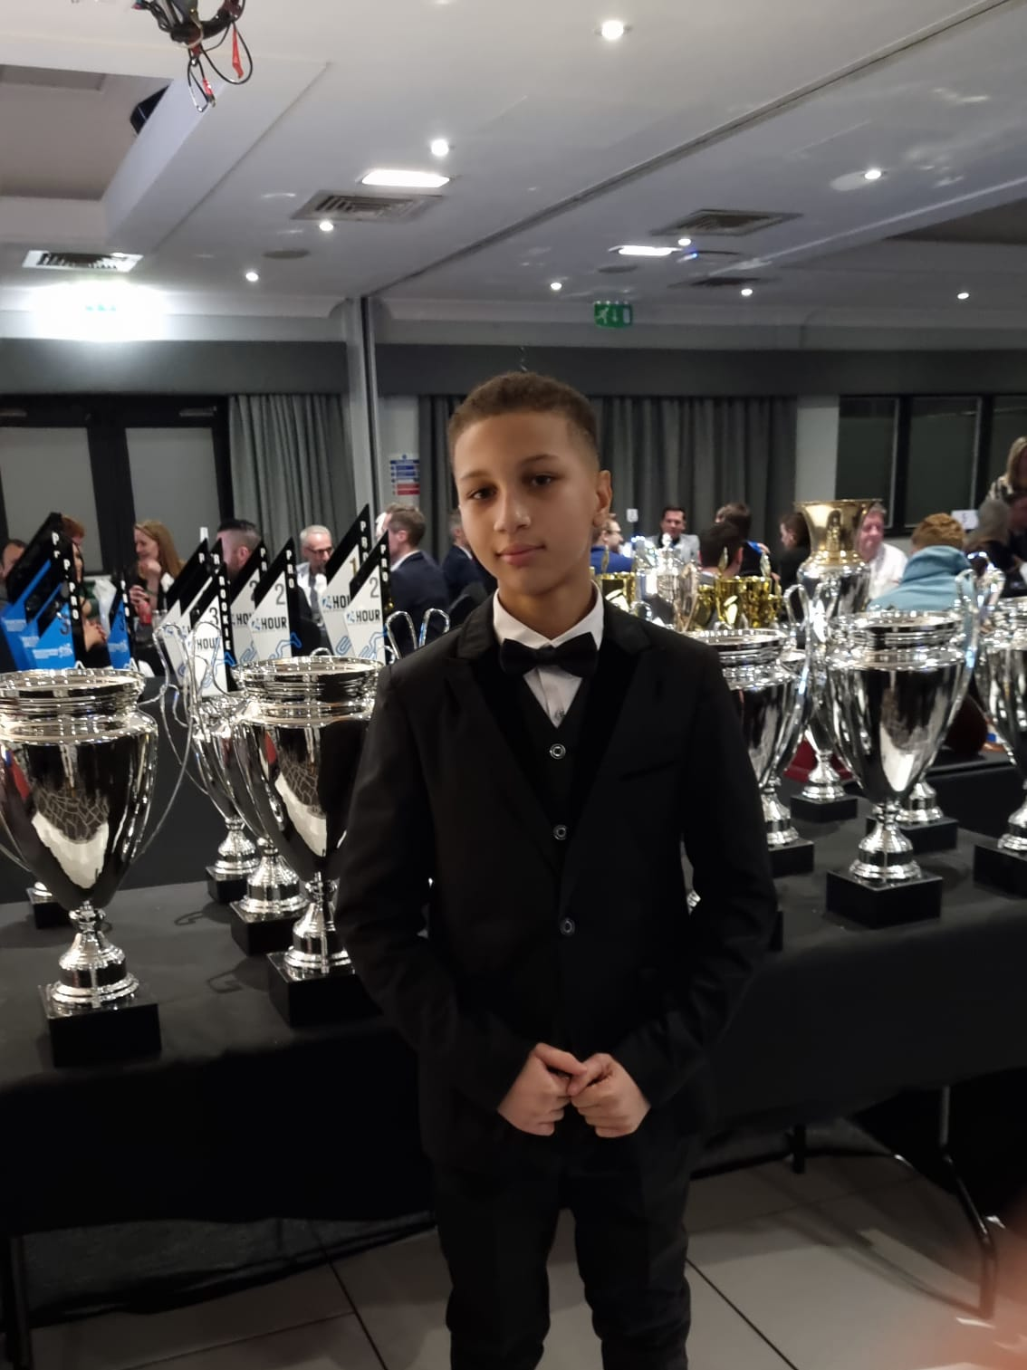
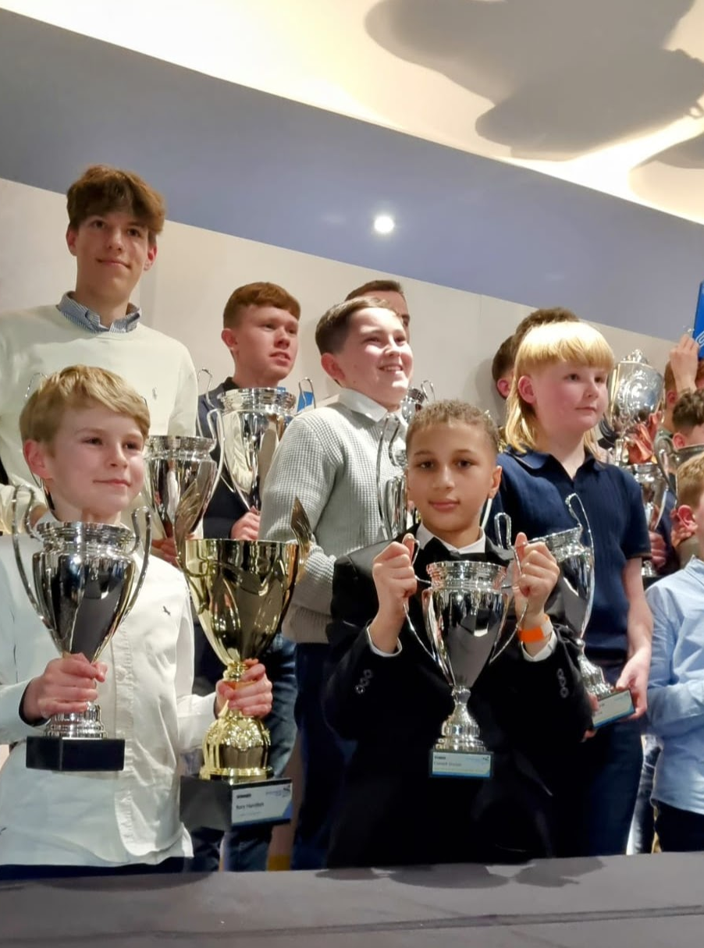
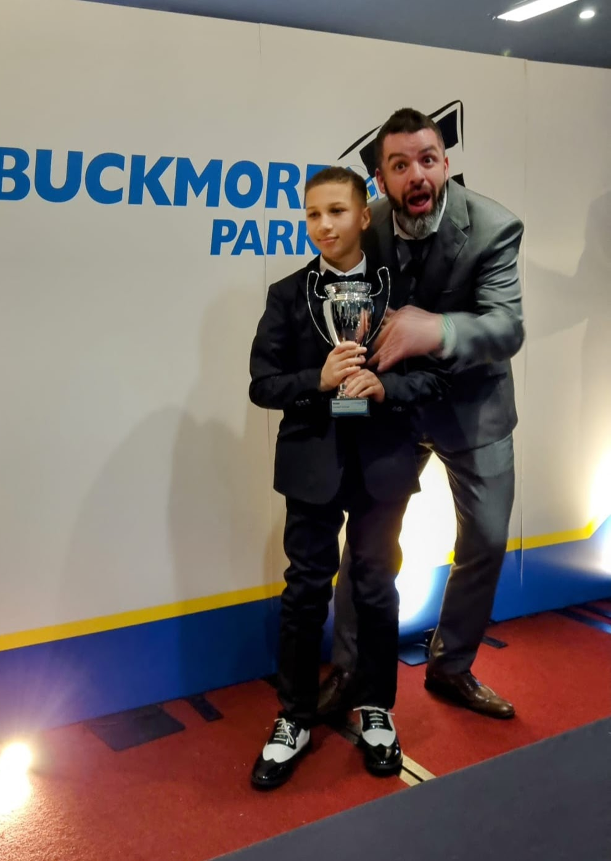
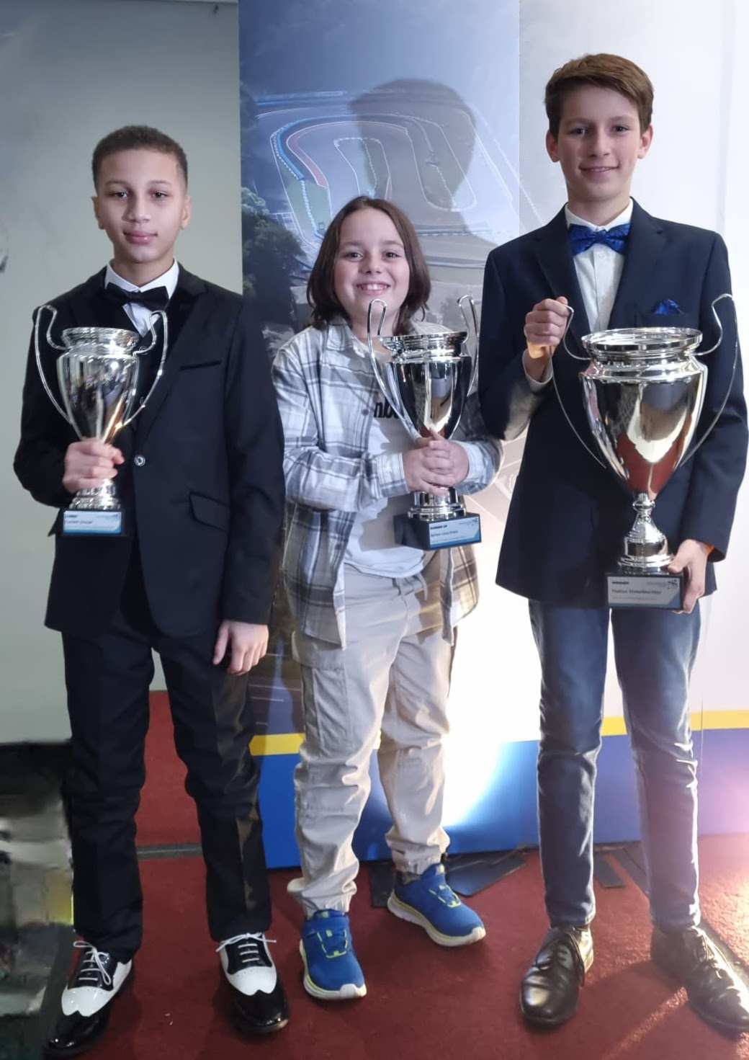
Gallery
2023 Championships

Slide 14
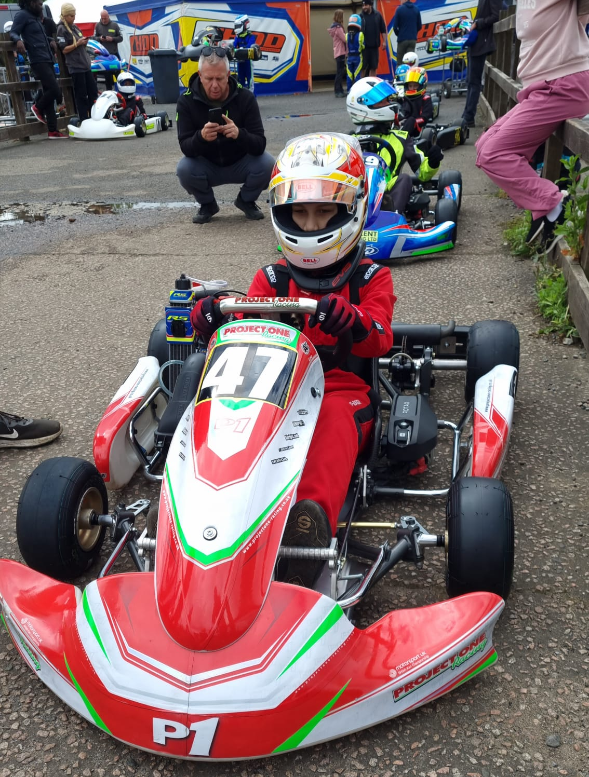
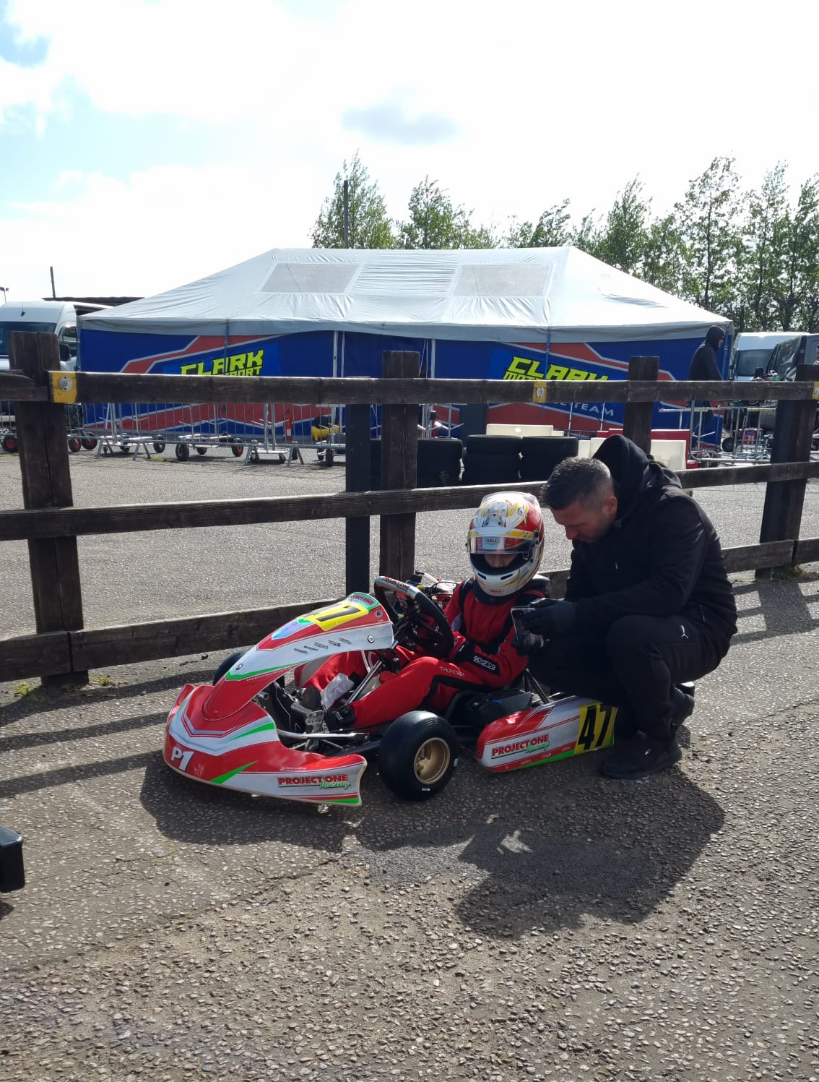
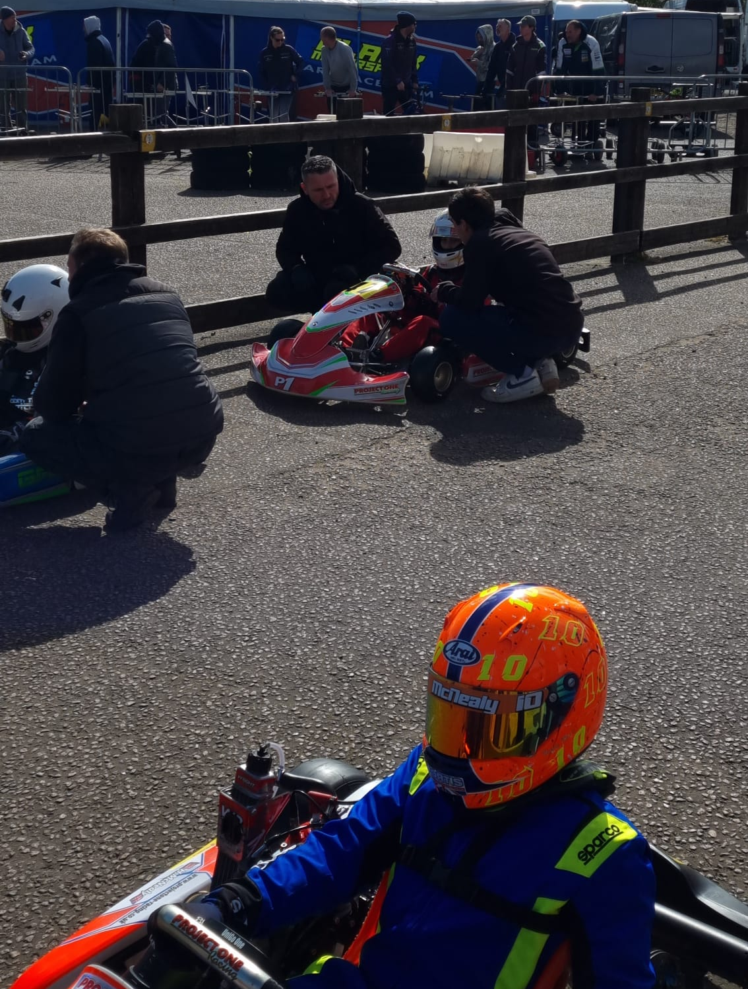
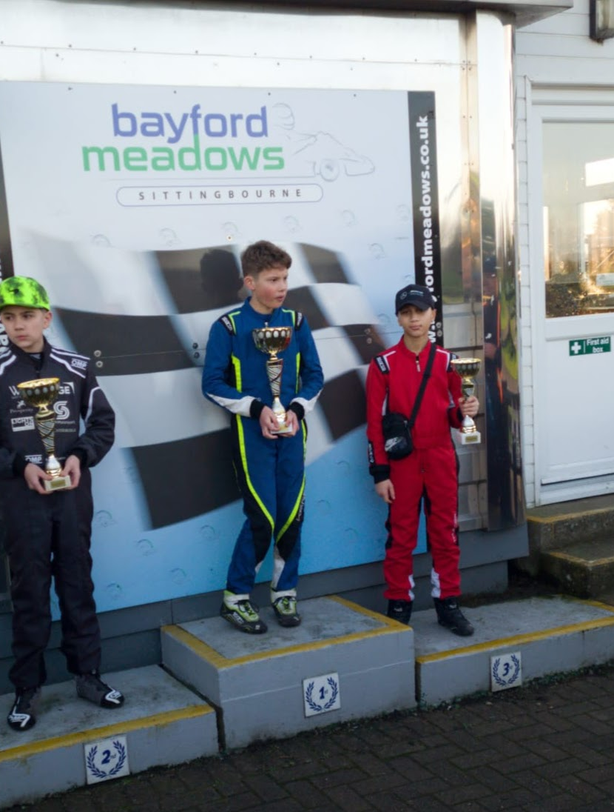
Gallery
Owner Driver BM Plate 2024

Slide 15
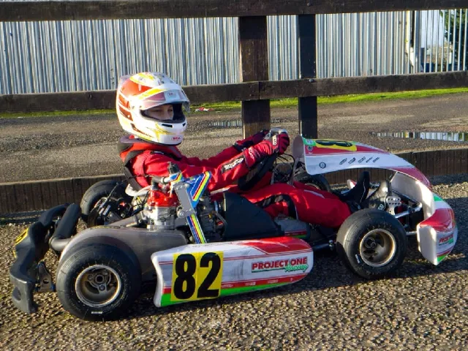
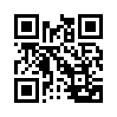
Fuel a Dream: Cordell Sinclair's Racing Career
gofund.me/547c26
Fundraiser
Alternatively, you can donate to Cordell’s GoFundMe account would be gratefully received. https://gofund.me/126f47da
Scan to donate

Slide 16
Contact:
+44 (0)7947931249
c.d.sinclair11@hotmail.com
cordells01
Cordell’s Racing

