Slide 1
Marketing Opportunities
Be part of it…
Take advantage of this fantastic opportunity and become a sponsor of Taminder Gata-Aura and the sport of Squash. Not only will you be supporting local Squash and Racquetball, but you will also be significantly raising the profile of your company to over 10,000 people.
Contact Details:
Address:
41 Stapper green, Wilsden, Bradford. BD15 0HQ
Born: Bradford, England – 6th May 1994
Telephone: 07772393911
Email: taminderga@hotmail.com

Slide 2
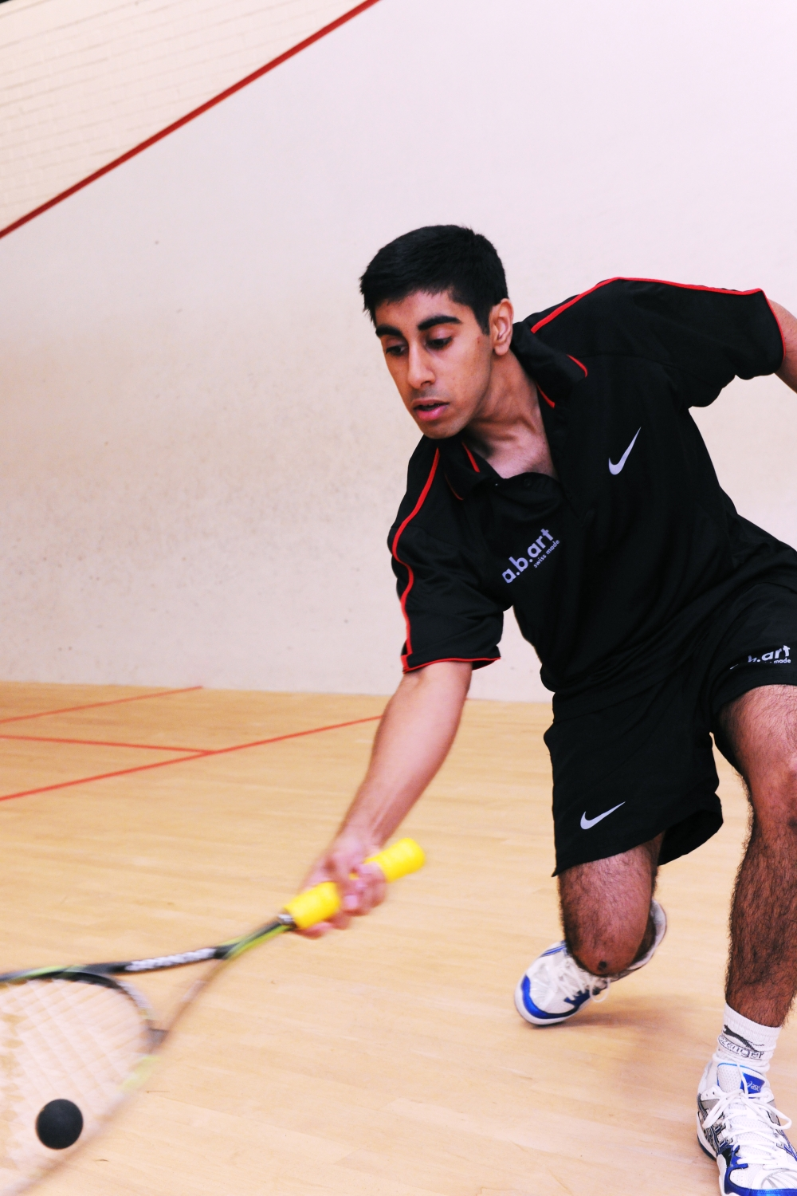
Only those who risk going to far can possibly find out how far one can go…
Taminder Gata-Aura is one of the highest achieving British Asian’s Under 19 on the Squash circuit. He is recognised as one of the fastest and fittest players in the professional game.
Taminder began playing at the age of six at the local Squash club in Wilsden. Ever since an early age Taminder has shown determination and racket skills. Throughout the junior years he’s been Yorkshire and North East No: 1 in his all age groups and has also reached within the top 3 English Junior rankings in all age groups.
In Taminder’s junior career he reached No: 3 in the Boys Under 19’s category and 8 in Europe!
Ranked 284 on PSA Tour He plays No:2 in the Yorkshire Premier League for Pontefract.
Taminder has represented England in a few International Matches. He represented England In the World Championships 2012 in Qatar.
Tammy D as known on Squash circuit now has the task of putting Wilsden and Yorkshire on a World stage in the Professional squash tour (PSA).

Slide 3
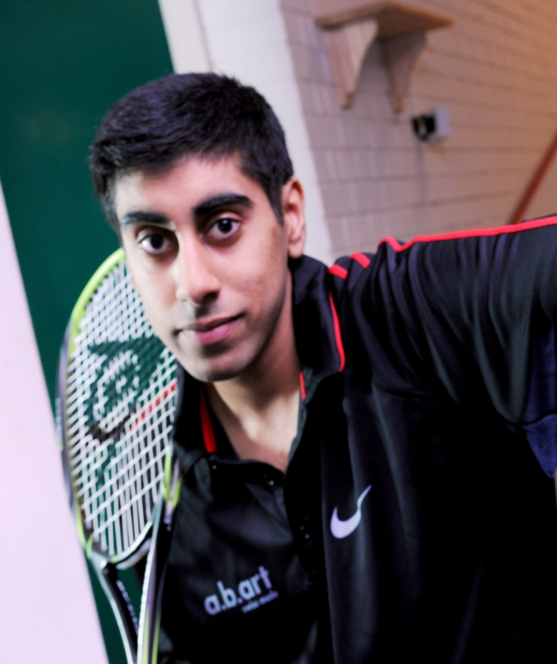
Achievements:
5 Times Yorkshire County Championships Winner
North East Area Closed Champion in all age groups
Pontefract Junior Open Champion in all age groups
Ilkley Junior Open Champion
Chapel Allerton Junior Open Champion
Irish Junior Open Champion
Manchester Junior Open Champion
Gloucestershire Junior Open Champion
Heaton Junior Open Champion
Chichester Junior Open Champion
Represented England in Home Internationals and other events
Represented England in Home Nations U13s and U15s
Represented England in the 2011 Hong Kong Junior Open U19s
Selected for World Junior Champs 2012 in Doha, Qatar
Sweden (Nordic) U19 2012 3rd
Hull Silver 2013 Champion
German Junior Open Championship 2013 Runner Up

Slide 4
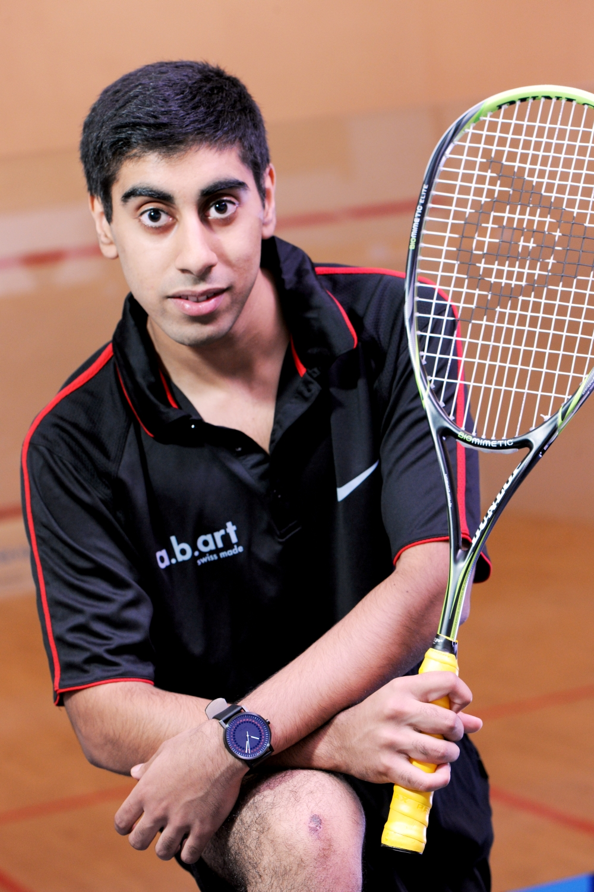
Why Sponsor Taminder and Squash?
Association with an upcoming World class sportsman
Squash & Racquetball are the fastest growing sports
Help towards improving Taminder’s game and travel coaching expenses.
Great media support, Yorkshire Evening post, Telegraph and Argus, Castleford and Pontefract Express, England squash & Racketball.com, Squashsite.co.uk (15,000 daily hits)
Fast, athletic and a clean sport & was voted “world’s healthiest sport” by FORBES magazine in the USA
Your name or company logo will be on all garments will be worn by Taminder at all competitions, league matches and exhibitions
Be associated with big companies/brands including:
Dunlop UK, a. b. Art

Slide 5
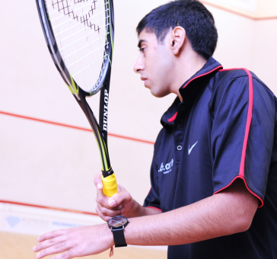
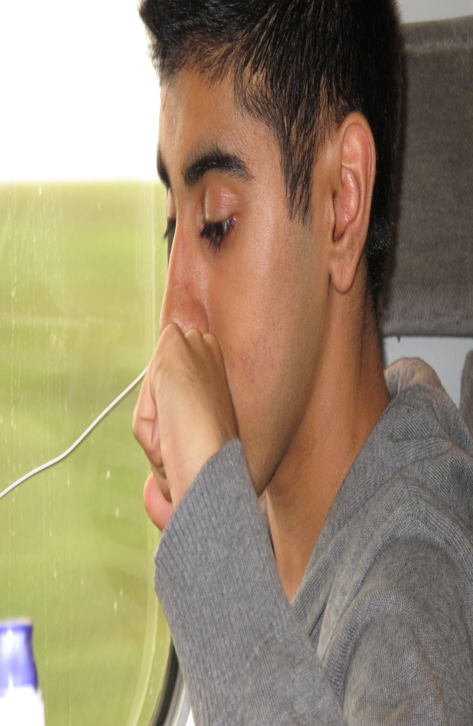
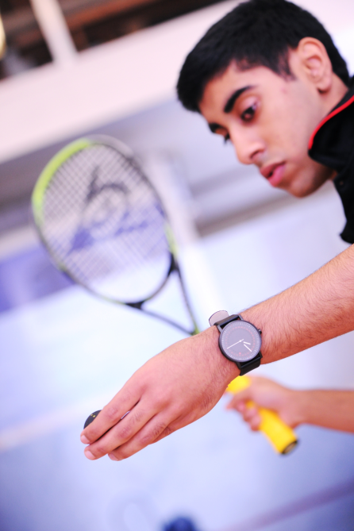
Targets:
Press Coverage:
Targets for current season:
Aim to play at No:1 in the 1st team of the Yorkshire Premier league for Pontefract
Break into World top 200 on PSA world tour
The Future:
Become a World top 10 Professional Squash Player
Keep learning and Loving the game
Play in Commonwealth Games
Hopefully in Olympics ( If squash gets into the 2020 games)
You and your company will benefit from media exposure in:
Local TV and radio
Local press
World squash media
Internet coverage
Personal Availability
Exhibition matches
Personal appearances for your company and clients
Personal squash lessons/matches
Company logo on kit worn in matches

Slide 6
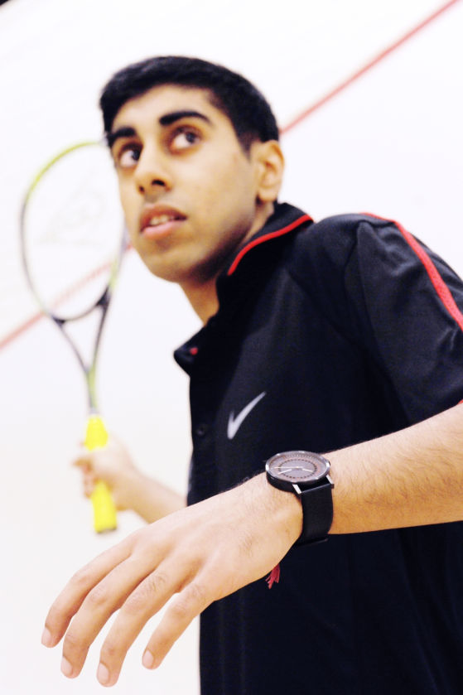
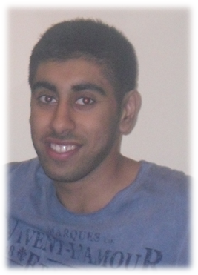
Sponsors & Partners
“Self Discipline is a must in Squash”

